Slide 1
Analyzing Algorithms
CS 400/600 – Data Structures

Slide 2
Problems
Problem – a mapping of input to output.
Algorithm – a method or a process followed to solve a problem.
A problem can have many algorithms.
Lecture 02: Analyzing Algorithms

Slide 3
Example Problems
Linear Search
  Input: An array A of integers, and a value v.
  Output: “Yes” if v is an element of A;
  “No” otherwise.
A =
3 12 7 25 7 32 11 56 28 43 6 87 68 91 2
v = 28
Algorithms: Exhaustive search; random search; sort and linear search; sort and binary search
Lecture 02: Analyzing Algorithms

Slide 4
Which is the best algorithm?
The one that runs fastest?
  For what input size?
  For what kinds of inputs?
The one that takes the least memory?
  Same questions
Other criteria?
  Simplicity
  Extensibility
  Provability
Lecture 02: Analyzing Algorithms

Slide 5
How fast is an algorithm?
To compare two sorting algorithms, should we talk about how fast the algorithms can sort 10 numbers, 100 numbers or 1000 numbers?
We need a way to talk about how fast the algorithm grows or scales with the input size.
  Input size is usually called n
  An algorithm can take 100n steps, or 2n² steps, which one is better?
Lecture 02: Analyzing Algorithms

Slide 6
Best, Worst, Average Cases
Not all inputs of a given size take the same time to run.
Sequential search for v in an array of n integers:
  Begin at first element in array and look at each element in turn until v is found
Best case:
Worst case:
Average case?
Lecture 02: Analyzing Algorithms
Notes:
Best: Find at first position. Cost is 1 compare.
Worst: Find at last position. Cost is n compares.
Average: (n+1)/2 compares IF we assume the element with value K is equally likely to be in any position in the array.

Slide 7
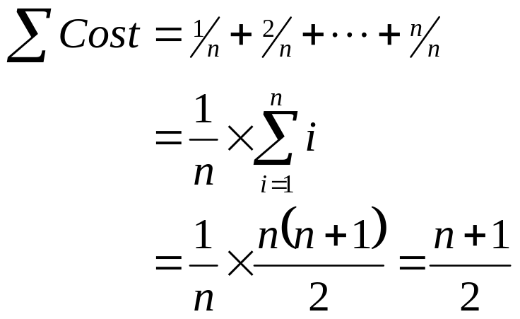
Linear Search – Average case
Case: i | Time: T(i) | Probability P(i) | Cost: T(i) * P(i)
1 | 1 | 1/n | 1/n
2 | 2 | 1/n | 2/n
3 | 3 | 1/n | 3/n
… | … | … | …
n | n | 1/n | 1
Lecture 02: Analyzing Algorithms

Slide 8
Linear Search with Failure
Suppose that each slot, i, in the array has probabity p of holding the value we are looking for, and that np < 1.
  The probability of not finding the value is 1 - np
Case: i | Time: T(i) | Probability P(i) | Cost: T(i) * P(i)
1 | 1 | p | p
2 | 2 | p | 2p
3 | 3 | p | 3p
… | … | … | …
n | n | p | np
Not found | n | 1-np | n× (1-np)
Lecture 02: Analyzing Algorithms

Slide 9
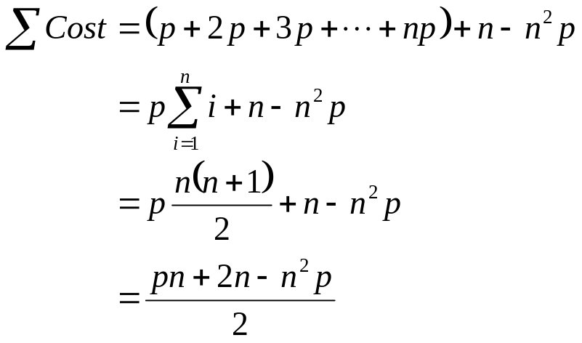
Linear Search with Failure
Case: i | Time: T(i) | Probability P(i) | Cost: T(i) * P(i)
1 | 1 | p | p
2 | 2 | p | 2p
3 | 3 | p | 3p
… | … | … | …
n | n | p | np
Not found | n | 1-np | n× (1-np)
When np=0, this is n.
When np = 1, it is (n+1)/2.
Lecture 02: Analyzing Algorithms

Slide 10
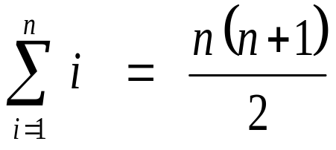
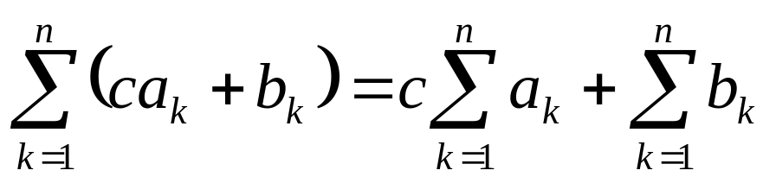
Series Sums
The arithmetic series:
  1 + 2 + 3 + … + n =
Linearity:
Lecture 02: Analyzing Algorithms

Slide 11
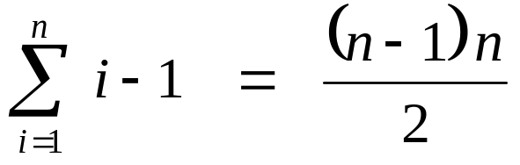
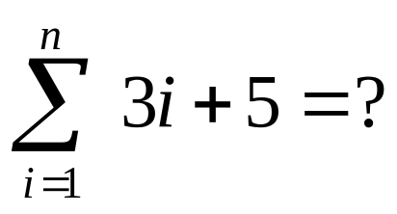
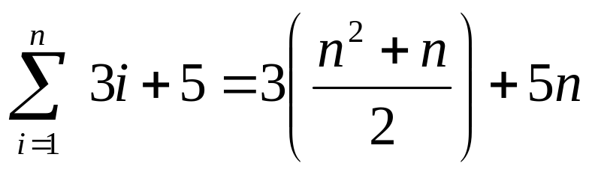
Series Sums
0 + 1 + 2 + … + n – 1 =
Example:
Lecture 02: Analyzing Algorithms

Slide 12
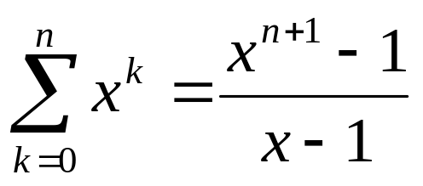
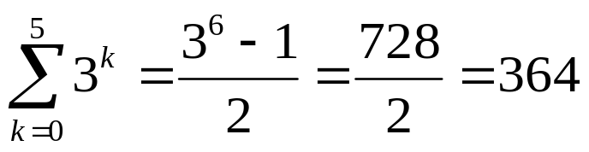
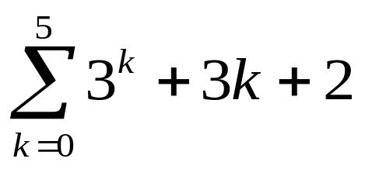
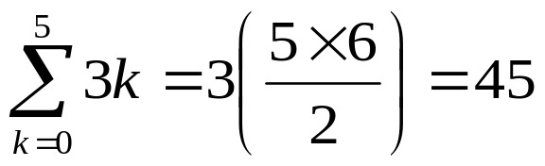
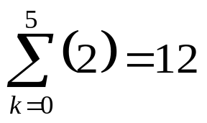

More Series
Geometric Series: 1 + x + x² + x³ + … + x^{n}
Example:
Lecture 02: Analyzing Algorithms

Slide 13
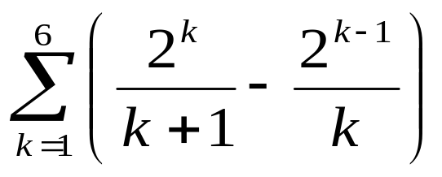
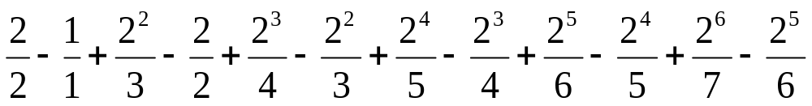
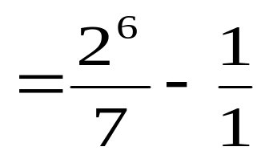
Telescoping Series
Consider the series:
Look at the terms:
Lecture 02: Analyzing Algorithms

Slide 14
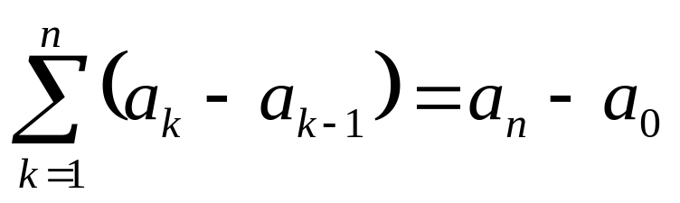
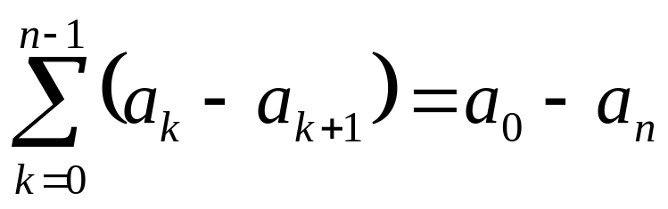
Telescoping Series
In general:
Lecture 02: Analyzing Algorithms

Slide 15
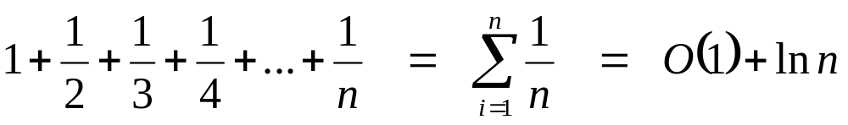
The Harmonic Series
Lecture 02: Analyzing Algorithms

Slide 16
Bubble Sort
Algorithm 1:
for pass = 0…n-1 {
for position = 0…n-1 {
if (array[position] > array[position+1]) {
swap (array[position], array[position+1])
}
}
}
Best, worst, average: T(n) ≈ (n²)
Lecture 02: Analyzing Algorithms

Slide 17
Bubble Sort
Algorithm 2:
for pass = 0…n-1 {
for position = 0…n-pass-1 {
if (array[position] > array[position+1]) {
swap (array[position], array[position+1])
}
}
}
Best, worst, average: T(n) ≈ (n²)
(Within a constant factor)
Lecture 02: Analyzing Algorithms

Slide 18
Bubble Sort
Algorithm 3:
for pass = 0…n-1 {
swaps = 0;
for position = 0…n-pass-1 {
if (array[position] > array[position+1]) {
swap (array[position], array[position+1]);
swaps++;
}
if (swaps == 0) return;
}
}
Best: T(n) ≈ n,
Worst: T(n) ≈ (n²)
Average = ??
Lecture 02: Analyzing Algorithms

Slide 19
Mergesort
7
2
9
4
6
9
4
6
Let M_{n} be the time to MergeSort n items
  M_{n} = 2(M_{n/2}) + n
Recurrence relations
..............................= n
n
n/2
n/2
..............................= n
n/2
n/2
n/4
n/4
n/4
n/4
n/4
n/4
n/4
n/4
..............................= n
How many levels deep will this tree grow?
Lecture 02: Analyzing Algorithms

Slide 20
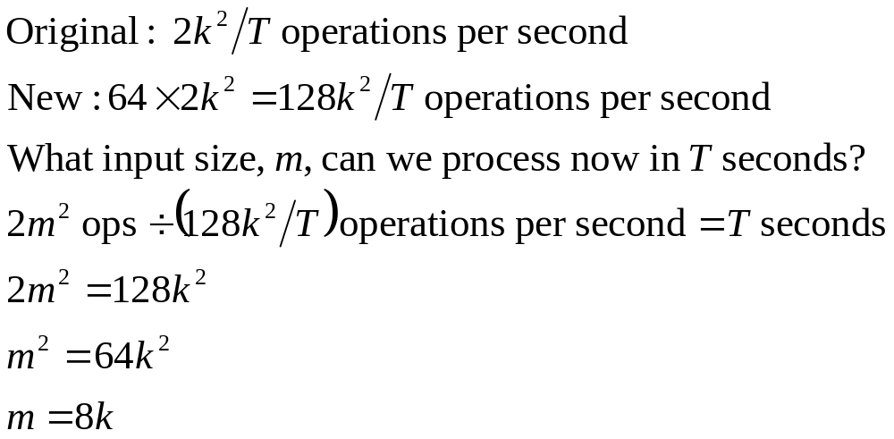
Faster Computer or Faster Algorithm?
Suppose, for your algorithm, f(n) = 2n²
In T seconds, you can process k inputs
If you get a computer 64 times faster, how many inputs can you process in T seconds?
Lecture 02: Analyzing Algorithms

Slide 21
Faster Computer or Algorithm?
If we have a computer that does 10,000 operations per second, what happens when we buy a computer 10 times faster?
T(n) | n | n’ | Change | n’/n
10n | 1,000 | 10,000 | n’ = 10n | 10
20n | 500 | 5,000 | n’ = 10n | 10
5n log n | 250 | 1,842 | √10 n < n’ < 10n | 7.37
2n² | 70 | 223 | n’ = √10n | 3.16
2^{n} | 13 | 16 | n’ = n + 3 | -----
Lecture 02: Analyzing Algorithms
Notes:
How much speedup? 10 times. More important: How much increase in problem size for same time expended? That depends on the growth rate.
n: Size of input that can be processed in one hour (10,000 steps).
n’: Size of input that can be processed in one our on the new machine (100,000 steps).
Note: for 2^{n}, if n = 1000, then n’ would be 1003.

Slide 22
Traveling Salesman Problem
n cities
  Traveling distance between each pair is given
  Find the circuit that includes all cities
25
E
15
22
12
F
21
A
35
8
10
D
B
23
20
22
19
19
14
25
G
C
33
Lecture 02: Analyzing Algorithms

Slide 23
Growth of Functions
Table 14.4 Growth of Several Common Functions
n | log₂(n) | n² | n³ | 2^{n} | n!
5 | 2 | 25 | 125 | 32 | 120
10 | 3 | 100 | 1000 | 1,024 | 3,628,800
20 | 4 | 400 | 8,000 | 1,048,576 | 2.4×10¹⁸
30 | 4 | 900 | 27,000 | 1.0×10⁹ | 2.4×10³²
40 | 5 | 1,600 | 64,000 | 1.1×10¹² | 8.1×10⁴⁷
50 | 5 | 2,500 | 125,000 | 1.1×10¹⁵ | 3.0×10⁶⁴
100 | 6 | 10,000 | 1,000,000 | 1.2×10³⁰ | >10¹⁵⁷
200 | 7 | 40,000 | 8,000,000 | 1.6×10⁶⁰ | >10³⁷⁴
Lecture 02: Analyzing Algorithms

Slide 24
Is there a “real difference”?
10^1
10^2
10^3 Number of students in the college of engineering
10^4 Number of students enrolled at Wright State University
10^6 Number of people in Dayton
10^8 Number of people in Ohio
10^10 Number of stars in the galaxy
10^20 Total number of all stars in the universe
10^80 Total number of particles in the universe
10^100 << Number of possible solutions to traveling salesman (100)
Traveling salesman (100) is computable but it is NOT tractable.
Lecture 02: Analyzing Algorithms

